Slide 1
Instructions
Retain the formatting (font style and so on in this template), where possible
Retain the Acknowledgements page
Use the images in the Seabirds Manual (most of them are on the website)
Ensure the credits for the images are noted in the “Image credits” slide at the end of the presentation, and / or on the slide they appear on (see the next slide for an example)
Notes:
Each slide needs to have notes that have the “script” for the slide. This is so that the trainers can use the materials effectively.

Slide 2
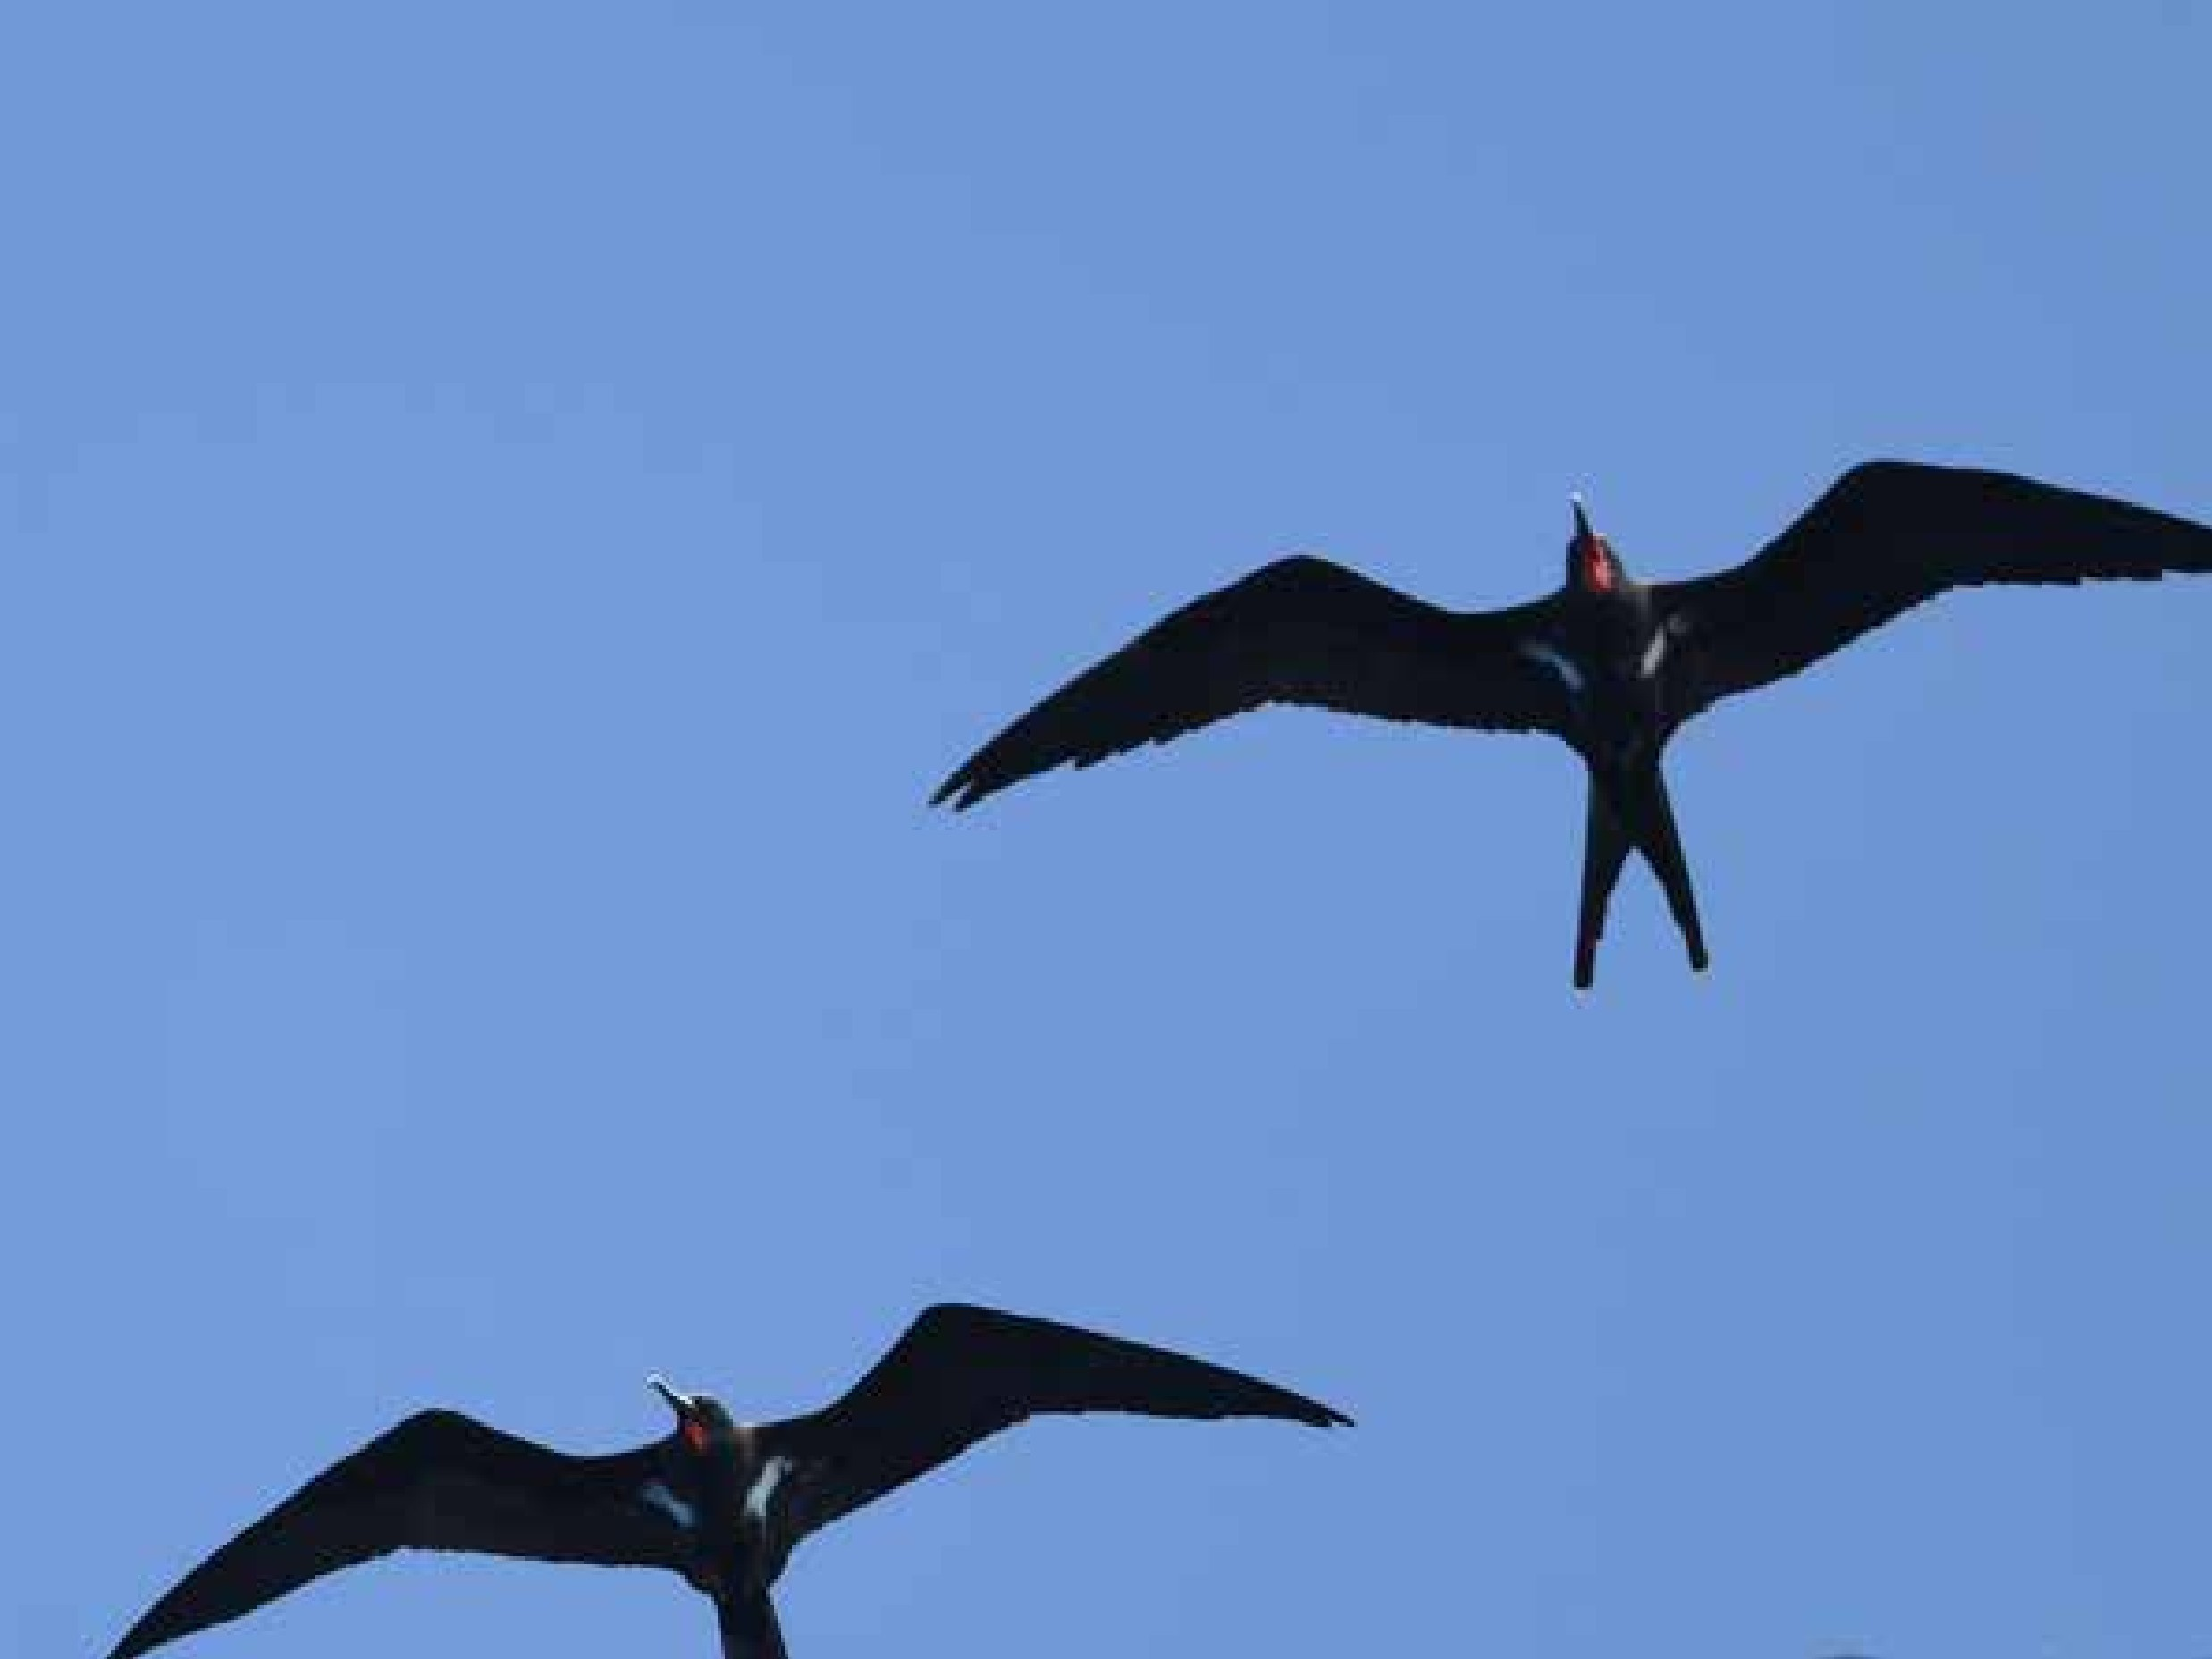
Palau Seabird Monitoring Workshop
Place, Date
Presenter names
Notes:
Cover slide image: Lesser Frigatebirds, Kiribati. Hiroyuki Tanoi

Slide 3
Title slide
Presenter
Notes:
Usse this slide as a placeholder for different days or different sessions, or when presenters change

Slide 4
Objectives of the workshop
Add objectives
Notes:
The purpose of the training-of-trainers introduction is to familiarise future trainers in seabird monitoring in Palau with the resources to support their training activities.
The resources to support the activities are found on a website.
The objectives of this training-of-trainers workshop are to enable participants to
Use the training-of-trainers resources to train others in seabird surveys and monitoring
Modify Palau pages and resources on the website
The next three days of the Palau workshop also provide a demonstration of how the training could be delivered by trainers in future events.

Slide 5
Today’s topics
Add topics

Slide 6
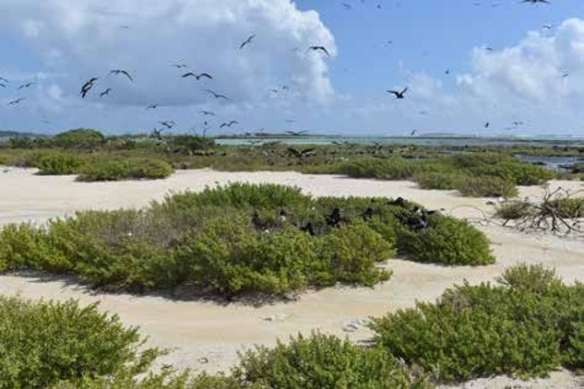
Example content slide with image
Image of some seabirds
Notes:
Image: ‘Gull Islets’, Suwarrow Atoll, Cook Islands. Photo: Te Ipukarea Society: https://seabirds.pacificbiosecurity.co.nz/index.php?page=executive-summary

Slide 7
Acknowledgements
This workshop was derived from the Pacific Seabirds Survey and Monitoring Manual, which was prepared under contract (AP_2/43) between the Secretariat of the Pacific Regional Environment Programme (SPREP) and the Northern New Zealand Seabird Trust (NNZST)
The Palau workshop resources were developed by Ray Pierce (Eco Oceania) and Monica Gruber (Pacific Biosecurity), based on the resources in Pacific Seabirds Survey and Monitoring Manual, under contract (2026-PBS-001: AP_2/43) between SPREP and Pacific Biosecurity, and deployed on the website: https://seabirds.pacificbiosecurity.co.nz
The project team also acknowledges the contribution of Karen Baird, SPREP's former Threatened and Migratory Species Adviser, who led efforts to develop more seabird resources on behalf of Pacific governments, for the benefit or Pacific communities.
Contributors to the Pacific Seabirds Survey and Monitoring Manual
  Principal authors and editorial team: Chris P. Gaskin (NNZST), André F. Raine (Archipelago Research & Conservation), Kerry A. Lukies (NNZST) and Edin A. Whitehead (NNZST).
  Case study and section contributions by: Alex Wegmann, Katie Franklin, Dana Sabine, Nick Holmes (The Nature Conservancy); Peter Allen, Rohan Clarke, Karina Sorrell (Monash University); Tehani Withers (SOP Manu); Andreas Ravache (Bird Conservation New Caledonia); Nicholas Carlile (Æstrelata Restorations); Richard Griffiths, Paula Castano, Paul Jacques (Island Conservation); Megan Friesen (Wenatchee Valley College); Matt Rayner (Auckland Museum); Sara Thompson, William Sydeman (Farrallon Institute); Kathy Kuletz (U.S. Fish and Wildlife Service); Sophie Laran (La Rochelle Université – CNRS); Stephanie Borrelle and Mark O’Brien (BirdLife Pacific); Steffen Oppel (Swiss Ornithological Institute); Marc Travers (Archipelago Research & Conservation).
  Also, special thanks to Graeme Taylor, Nicholas Carlile, Jay Penniman and Steffen Oppel for reviewing the draft manuscript.
  Participants in the needs assessment review: Bird Conservation New Caledonia; Te Ipukerea Society, Cook Islands; SOP Manu – Polynesian Ornithological Society, French Polynesia; Samoa Conservation Society, Samoa; Vava’u Environmental Protection Association (VEPA), Tonga; American Bird Conservancy (ABC), ABC Marine Programme; Nicholas Carlile; Eric Vidal; Graeme Taylor; Peter Frost; Ray Pierce; Mark O’Brien; Yuna Kim; Jay Penniman; Alex Wang; Brett Mossman; Peter Vaughan; Rohan Clarke; Eric Woehler; Kazuto Kawakami; Kentaro Kazama; Steffen Oppel.
  Numerous photographers have generously contributed images; credits accompany the images.
  Cover images: White-tailed Tropicbird on nest on the island of Kaua’i, Hawaii. Photo: André F. Raine; Sooty Tern colony at Chesterfield Reef, New Caledonia. Photo: Mathieu Mathivet; ‘New Caledonian Storm-petrel’. Photo: Hadoram Shirihai; Research team on Tauturoa, Rapa, French Polynesia. Photo: Tehani Withers.
  Graphic design and layout: Carlo Iacovino.

Slide 8
Image credits
The numbers in this list refer to the figure numbers in the Pacific Seabirds Survey and Monitoring Manual. Credits for others are noted here and / or in the images (see example)
  Cover slide image: Lesser Frigatebirds, Kiribati. Hiroyuki Tanoi
  Figure 1. ‘Gull Islets’, Suwarrow Atoll, Cook Islands. Photo: Te Ipukarea Society

Slide 9
The following slides are examples from the Microsoft powerpoint template and can be deleted if not used

Slide 10
Title and Content Layout with Chart

Slide 11

Picture with Caption Layout
Caption

Slide 12
Two Content Layout with Table
First bullet point here
Second bullet point here
Third bullet point here
Class | Group A | Group B
Class 1 | 82 | 95
Class 2 | 76 | 88
Class 3 | 84 | 90

Slide 13
Two Content Layout with SmartArt
First bullet point here
Second bullet point here
Third bullet point here
Group A
Group B
Group C

